Slide 1
Thermistors and Strain Gauge
A project report of Physics

Slide 2
01
THERMISTORS
Types, Compositon, Principle and Advantages

Slide 3
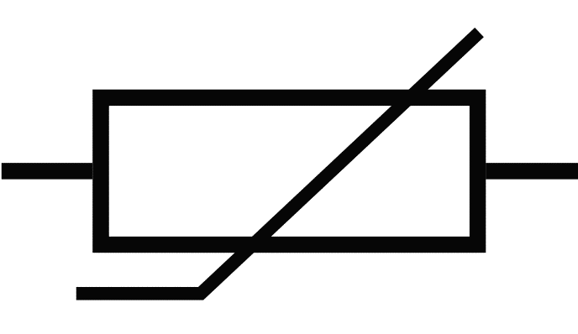
Introduction to Thermistors
Thermistors are temperature-sensitive resistors that are commonly used in various electronic devices and applications. It is a resistance thermometer, or a resistor whose resistance is dependent on temperature. The term is a combination of “thermal” and “resistor”. It is made of metallic oxides, pressed into a bead, disk, or cylindrical shape and then encapsulated with an impermeable material such as epoxy or glass.
Symbol of Thermistor

Slide 4


TYPES OF THERMISTORS
NTC Thermistor
In an NTC thermistor, when the temperature increases, resistance decreases. This type of thermistor is used the most. NTC thermistors are typically made of metal oxides, such as titanium, nickel, or manganese, which are mixed with ceramic materials to form a semiconductor material.
PTC Thermistor
In an PTC thermistor, when temperature decreases, resistance increases. PTC thermistors are made from a variety of materials such as barium titanate, lead titanate, and polycrystalline ceramic materials.

Slide 5
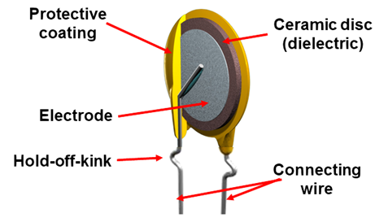
Composition of Bead-shaped Thermistors
Bead-shaped thermistors are fabricated by applying a slurry of metal oxides with a binder onto spaced platinum alloy lead wires. The binder is the essential part of the process and supplies the appropriate level of surface tension to draw the material into the bead shape. Bead thermistors offer high stability, fast response, and operate at high temperatures and exhibit a low dissipation constant. They can be as small as 0.0004 in (0.01 mm) to 0.05 in (1.2 mm).

Slide 6
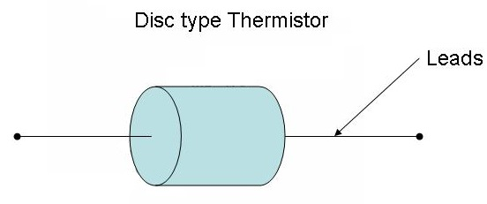
Composition of Disc-shaped Thermistors
Disc type thermistors are manufactured by pressing oxide powders into a circular mould. The pressed materials are sintered at a high temperature under pressure to form a cylindrical shape with diameters of 0.094 in to 0.98 in (2.5 mm to 25 mm). The widely varying sizes of disc type thermistors offers a selection of thermistors to fit any application.

Slide 7
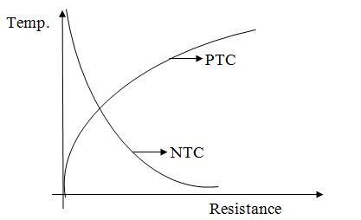
Principle of Thermistors
The basic working principle of a thermistor is that its resistance is dependent on temperature. Its resistance is measured by an ohm meter, which is a device that measures electrical resistance. When examining thermistors, it should be remembered that they do not read values, but their resistance varies with temperature. The amount of resistance is determined by the substance applied to a device. Thermistors are unlike linear sensors because they are non-linear, with the points on a graph representing temperature and resistance.

Slide 8
Continue……..
By knowing how temperature changes affect the resistance in a thermistor, the acquired data can be used to obtain a temperature reading. The relationship between the two factors is non-linear and produces a curve instead of a line.
All resistors change in relationship to temperature, an effect that is measured by temperature coefficient resistance, which is represented by a change in resistance. With typical resistors, there is a form of temperature change during performance. For thermistors, a large temperature coefficient resistance change is necessary to be able to measure temperature.

Slide 9
Temperature Coefficient of Thermistor
Thermistor
Resistor
01
02
Breadboard
Multimeter
03
04
Choose a thermistor with a resistance value that is appropriate for your application. The thermistor should have two leads that you can connect to your breadboard.
You will need a fixed resistor that is approximately the same resistance value as the thermistor. This resistor will be used to create a voltage divider circuit with the thermistor.
A breadboard is a useful tool for creating and testing electronic circuits. Make sure your breadboard has sufficient space to accommodate all components
You will need a multimeter to measure the voltage across the thermistor and the fixed resistor.

Slide 10
Once you have gathered your components, follow these steps to measure the value of the thermistor:
Insert the thermistor and the fixed resistor into the breadboard. Connect one end of the fixed resistor to the positive rail of the breadboard and connect the other end of the resistor to the negative rail.
Connect one lead of the thermistor to the negative rail of the breadboard and the other lead to the point where the fixed resistor and the thermistor meet
Set your multimeter to measure DC voltage.
Connect the positive lead of the multimeter to the point where the fixed resistor and the thermistor meet, and connect the negative lead of the multimeter to the negative rail of the breadboard
Apply a voltage to the circuit. You can use a battery or a power supply to provide a voltage to the circuit. Make sure the voltage is appropriate for your components.

Slide 11
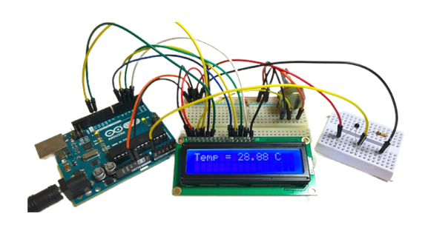
Read the voltage across the thermistor and the fixed resistor on your multimeter. Use Ohm's law to calculate the resistance of the thermistor. The resistance of the thermistor is equal to the resistance of the fixed resistor multiplied by the ratio of the voltage across the thermistor to the total voltage across the circuit.
Repeat the measurements for different temperatures to determine the temperature coefficient of the thermistor.

Slide 12

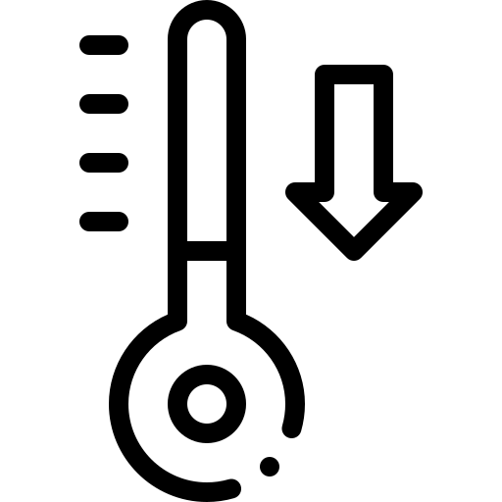




Advantages of Thermistors
Lower cost
No Overheating
Assorted Uses
Smaller size
Accuracy
Customization
They provide accurate data for small temperature range at low cost
Thermistor absorbs the heat in the circuit to reach set amount of resistance
They are also ued to measure pressure, liquid levels and power
Though they are available in small sizes, thermistors are exceptionally durable and long-lasting.
Thermistors operate over a small temperature range, their readings are more precise.
Their multiple types and sizes allow them to be used in any operation, condition, or situation.

Slide 13
02
Strain Gauge
Compositon, Mechanism and Advantages

Slide 14
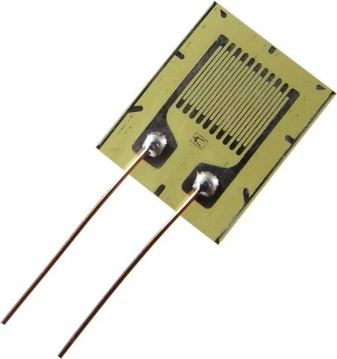
Introduction to Strain Gauge
Strain gauges are devices that are used to measure strain or deformation in a material. They are commonly used in physics to measure the amount of stress and strain experienced by an object.
A strain gauge typically consists of a thin metal wire or foil that is attached to the surface of the material being measured. When the material is subjected to stress or strain, the wire or foil changes shape and its electrical resistance changes as well. By measuring this change in resistance, the amount of strain on the material can be calculated.

Slide 15
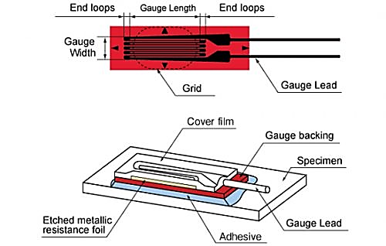
Composition of Strain Gauge
A strain gauge is typically made of a thin metal foil (usually made of Constantan or Karma alloy) that is bonded to a backing material, such as paper or plastic. The gauge is then attached to the surface of the object being measured using a special adhesive. When the object is subjected to deformation, the strain gauge also deforms, causing the metal foil to stretch or compress. This deformation causes a change in the electrical resistance of the metal foil, which is measured using a Wheatstone bridge circuit.

Slide 16
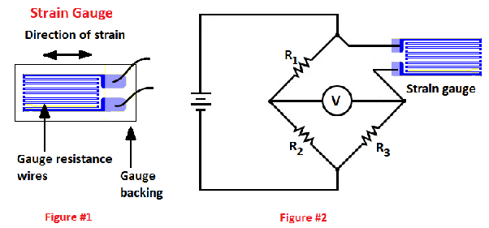
Mechanism of Strain Gauge
The Wheatstone bridge circuit is a network of four resistors connected in a diamond pattern. The strain gauge is connected in one arm of the bridge, and a voltage is applied across the bridge. When the object being measured is deformed, the resistance of the strain gauge changes, causing an imbalance in the bridge circuit. This imbalance produces a small electrical signal that is proportional to the amount of strain applied to the gauge.

Slide 17



Advantages of Strain Guage
Sensitivity
Non- intrusive
Versatile
Cost-effective
Integration
They can detect small chage in deformation or strain.
Strain gauges do not require any physical contact with the object being measured.
Strain gauges can be used to measure strain in a wide range of materials
They are relatively inexpensive to other types of sensors.
Strain Gauge can be easily integrated with other electronic components

Slide 18
Conclusion
In conclusion, both thermistors and strain gauges are useful sensors for measuring physical parameters. Thermistors are temperature sensors that change resistance with changes in temperature, making them ideal for monitoring temperature changes in a wide range of applications. Strain gauges, on the other hand, are used to measure changes in length or deformation of an object under stress.
While both sensors have different applications, they share some similarities. For example, both thermistors and strain gauges are used in industrial and scientific settings to monitor and control various processes. They are also both sensitive to environmental factors such as humidity, which can affect their accuracy.
Overall, the choice of which sensor to use depends on the specific application and the parameters being measured. Thermistors are ideal for measuring temperature changes in a wide range of applications, while strain gauges are ideal for measuring stress and deformation in materials. Understanding the strengths and limitations of each sensor is crucial in selecting the right tool for the job.

Slide 19
THANKS!
Presentation By:
Kshitiz Rayamajhi
Anirudra Regmi
Niranjan Kattel

